Slide 1
Integrated Care Systems (ICSs) and the South East London ICS
January 2023

Slide 2
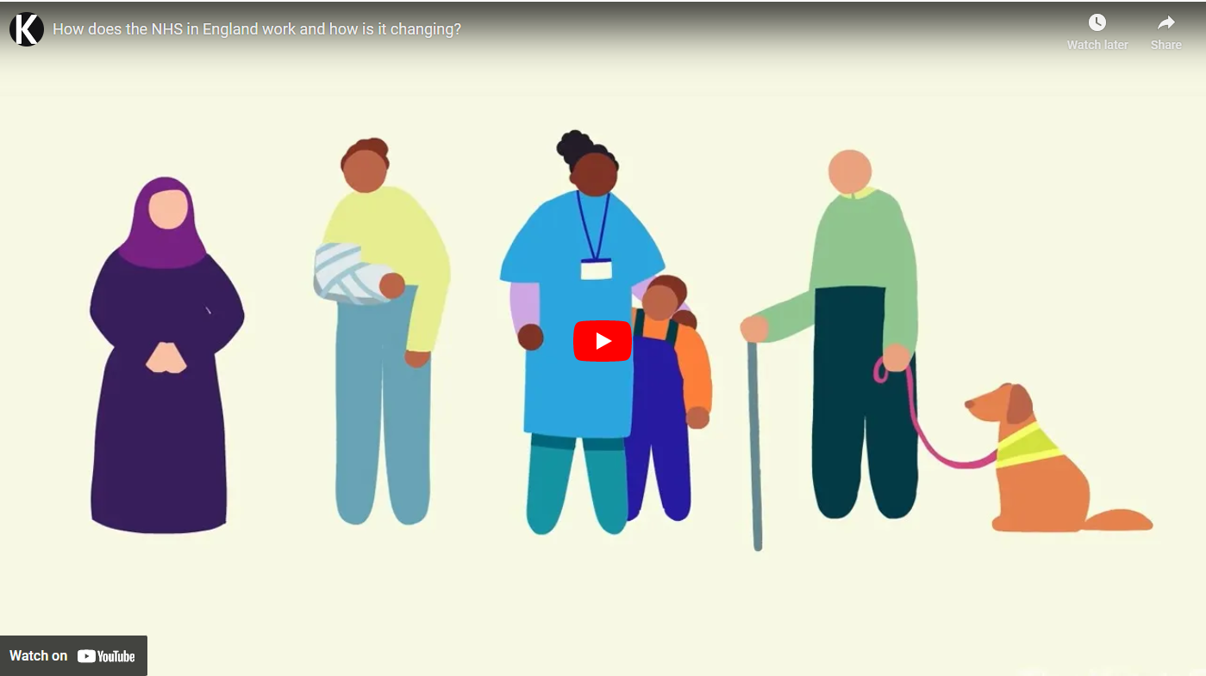
How does the NHS in England work and how is it changing?
https://www.kingsfund.org.uk/audio-video/how-does-nhs-in-england-work

Slide 3
The journey to Integrated Care Systems (ICS)
NHS Long Term Plan (2019) confirmed all parts of England would be served by an ICS
Our Healthier South East London becomes one of the first 15 ICSs in England.
April 2020: NHS South East London CCG became a statutory organisation – putting us in a position ready for progressing into ICS arrangements
November 2020: NHS England and Improvement (NHSEI) published Integrating Care - proposing two legislative options to further develop ICSs – option two was preferred by NHSEI
December: Staff engagement (along with other stakeholder engagement)
Health and social care bill published and receives Royal Assent in April 2022. Integrated Care Boards become statutory organisations on 1 July 2022.
The Department of Health and Social Care published Integration and innovation: working together to improve health and social care for all (11 February) based on NHSEI’s recommendations
These responses informed the NHSEI document ‘Legislating for ICSs: five recommendations to government and parliament’ published on 11 February 2021
The CCG submitted it’s response on 8 January 2021
3

Slide 4
Changes to the Health and Care Act 2022
Contains the biggest reforms to the NHS in nearly a decade, laying the foundations to improve health outcomes by joining up NHS, social care and public health services at a local level and tackling growing health inequalities
The majority of the Act is focused on developing system working with integrated care systems (ICSs) being put on a statutory footing through the creation of integrated care boards (ICBs)
It also moves the NHS away from competitive retendering by default and towards collaborative delivery
The Act formally merges NHS England and NHS Improvement and gives the secretary of state a range of powers of direction over the national NHS bodies and local systems and trusts
Other provisions include a new legal power to make payments directly to social care providers; the development of a new procurement regime for the NHS; and a new duty on the secretary of state to report on the system for assessing and meeting the workforce needs of the health service in England
Notes:
4

Slide 5
What these changes mean in context – a south east London perspective

Slide 6
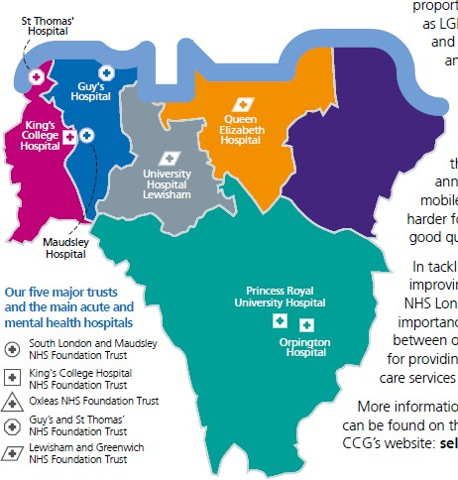
Our six boroughs
South east London is diverse, and the health and care needs of its 1.9 million people are complex
Our population is both growing and ageing; that means demand for health and care services is set to increase significantly as more people live longer
We have significant health inequality within our six boroughs. Life expectancy at birth can vary across south east London by up to nine years between the most and least deprived areas
People’s health is effected by the wider determinants of health – such as deprivation, local environment, housing, education, employment and social isolation – have a significant impact, including lifestyle choices
6

Slide 7
About our boroughs
Bexley
16% of Bexley’s population are aged 65 and over
16.3% of children living in Bexley live in low-income families
Life expectancy is 7.9 years lower for men and 6.7 years lower for women in the most deprived areas of Bexley, compared to the least deprived areas
Bromley
18% of Bromley’s population are aged 65 and over
13.2% of children living in Bromley live in low-income families
Life expectancy is 8.1 years lower for men and 6.1 years lower for women in the most deprived areas of Bromley, compared to the least deprived areas
Royal Greenwich
Royal Greenwich is ranked amongst the 30% most deprived local authority areas in the country
21.8% of children in Royal Greenwich live in low-income families
38% of Royal Greenwich’s population are from a Black and Minority Ethnic background
Lambeth
Lambeth is ranked amongst the 15% most deprived local authority areas in the country
Lambeth has the second largest lesbian, gay and bisexual communities in the country
60% of Lambeth’s population are from a Black and Minority Ethnic background
Lewisham
Lewisham is ranked amongst the 15% most deprived local authority areas in the country
22.6% of children in Lewisham live in low-income families
47% of Lewisham’s population are from a Black and Minority Ethnic background
Southwark
Southwark is ranked amongst the 15% most deprived local authority areas in the country
Southwark has the third largest lesbian, gay and bisexual communities in the country
46% of Southwark’s population are from a Black and Minority Ethnic background
7

Slide 8
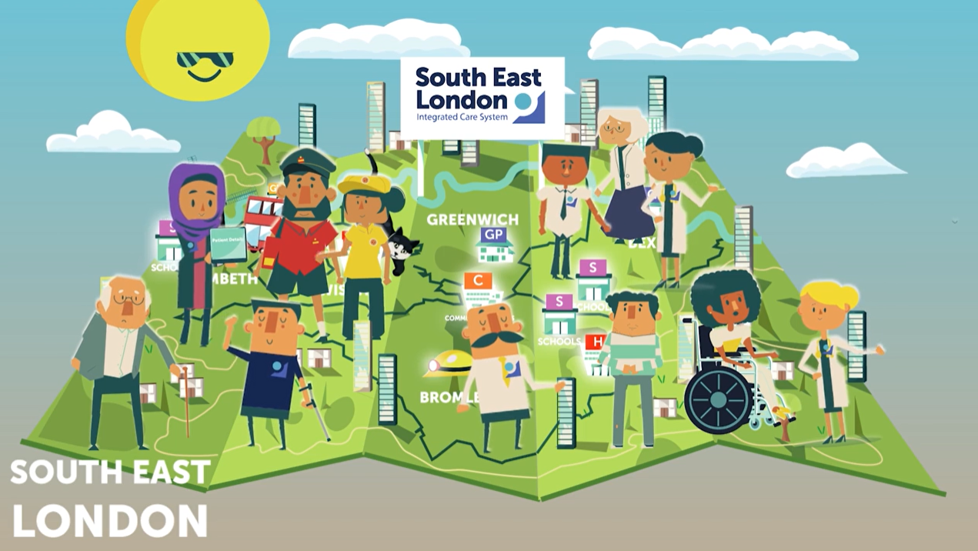
Understanding the Integrated Care System
https://bit.ly/WhatIsAnICS
8

Slide 9
NHS South East London – part of the South East London Integrated Care System
https://youtu.be/6uGJFHn8ntI
9

Slide 10
Our Integrated Care Board and System
Our purpose:
Improve outcomes in south east London population health and health and care services
Tackle inequalities in outcomes, experience and access suffered by the residents of south east London
Enhance productivity and value for money in the in the use of health and care resources in south east London
Help the NHS support broader social and economic development in south east London
Principles by which we’ll achieve it:
Partnership: We are a partnership of sovereign bodies coming together to achieve something greater than the sum of the partners. All partners have a voice and all partners have responsibility.
Subsidiarity: This means issues and decisions should be dealt at the most local level consistent with their effective resolution.
Accountability: We value both supporting each other and being held to account by each other and our wider partners.
10

Slide 11
Understanding system language
Integrated Care Systems (ICS) | The full range of organisations – the NHS, our local authorities, the voluntary, community, social enterprise (VCSE) sector, that play a role in organising and providing health and care in south east London and need to work together to better serve local people.
NHS South East London Integrated Care Board (ICB) | A group of senior leaders appointed from across our health and care system responsible for allocating resources, high-level planning and overseeing the performance of our health and care system. The NHS South East London ICB is the legal name for the board and the public name for the ICB is NHS South East London.
Integrated Care Partnership (ICP) | A group of senior leaders including leaders of the Integrated Care Board, our local authorities, our NHS providers, the VCSE and Healthwatch with specific responsibilities for helping to set and oversee strategic direction for our system.
Provider Collaboratives (PCs) | Partnerships between groups of NHS providers such as our acute providers and our mental health providers, responsible for working together to make better use of resources and improve the quality of more specialist services.
Local Care Partnership (LCP) | Partnerships between our local authorities, NHS organisations and the VCSE in our boroughs responsible for developing and overseeing out of hospital care.
Primary Care Networks (PCNs) | GP practices working together with community, mental health, social care, pharmacy, hospital, voluntary, community and social enterprise services in their local areas.
11

