Slide 1
World AIDS Day
2021: the story of HIV today

Slide 2
Overview
An introduction to HIV
5 HIV facts you need to know
Our HIV stories
What can you do?

Slide 3
What is World AIDS Day?
World AIDS Day is held every year on 1 December to raise awareness about HIV.
It is a day to show support for people living with HIV, remember those who have lost their lives because of HIV and learn the facts and realities of HIV today, in the UK and worldwide.

Slide 4
What is HIV?
HIV is a virus that attacks the body's immune system. It stands for Human Immunodeficiency Virus (HIV).
AIDS stands for Acquired Immune Deficiency Syndrome. It is a serious illness that can develop when HIV damages the immune system to such an extent that it can no longer fight off a range of infections it would normally cope with.
HIV is the not the same as AIDS.
AIDS only develops if HIV is left untreated.

Slide 5
Globally, how many people are living with HIV?
37.7 million
Notes:
Q: How many people are living with HIV in the entire world?
A: In 2020, there were around 37.7 million people living with HIV globally. In some countries, people can struggle to access testing or treatment.

Slide 6
How many people are living with HIV in the UK?
105,200
Notes:
Q: How many people are living with HIV in the UK?
A: Around 105,200 people were living with HIV in the UK as of 2019. Around 4,000 people are diagnosed with HIV every year in the UK.

Slide 7
Of everyone living with HIV in the UK, how many don’t know?
1 in 12
Notes:
Q: How many people are living with HIV in the UK but don’t know that they have it?
A: Of these, 1 in 12 people do not know they have HIV (or about eight per cent).

Slide 8
Here are 5 HIV facts you should know.
Notes:
These 5 key facts are things you should know about HIV.
Top tip: you might wish to prompt the class to write these down, or remember them, and prompt students to recall one each at the end.

Slide 9
Notes:
The first fact is that people on effective HIV treatment can’t pass it on.
Most people living with HIV in the UK (over 80% of them) are on effective treatment.
That treatment is usually one or two tablets per day.

Slide 10
Notes:
HIV can’t be passed on through day-to-day contact.
Question: does anyone know how you can pass on HIV?

Slide 11
How is HIV passed on?
In the UK, the two main routes of getting HIV are:
Having sex without condoms or other types of protection.
(Other forms of protection include PrEP, a medication a person can take to stop them from getting HIV, and HIV treatment. If a person living with HIV is on effective treatment, they can’t pass HIV on.)
2. Sharing needles and injecting equipment.
Notes:
A: In the UK, the two main routes of getting HIV is by:
Having sex without condoms or other form of protection. Other forms of protection include PrEP, a medication a person can take to stop them from getting HIV, and HIV treatment. If a person living with HIV is on effective treatment, they can’t pass HIV on.
2. Sharing needles and injecting equipment
Anyone can get HIV if they are exposed to HIV via these routes.
Elsewhere in the world, there is also a risk for pregnant women passing HIV on to their babies, but this doesn’t really happen in the UK because mothers are screened for HIV, and if they test positive they are put on treatment that helps stop it from being passed on.
These are the only ways HIV can be passed on. There is no risk of passing on HIV through day-to-day contact, like touching, kissing or any other way.
Top tip
Other examples of things you can’t get HIV from include biting, spitting, sharing cutlery, loo seats or sharing tooth brushes.

Slide 12
Notes:
Fact 3
HIV can affect anyone.
What do we mean by this?
What we mean is that, if you have been at risk in any of the ways mentioned before, you can get HIV.

Slide 13
Image source: Changing Perceptions
Notes:
These are just some people living with HIV in the UK today. They are different ages, have different genders and sexualities, and come from different backgrounds.
Some people are at more risk of HIV than others, perhaps because they come from places where HIV is more common, or because they move in communities where there are more people living with HIV.
But HIV doesn’t discriminate. It can affect anyone who has unprotected sex or shares needles.

Slide 14
Notes:
People living with HIV live long and healthy lives.

Slide 15
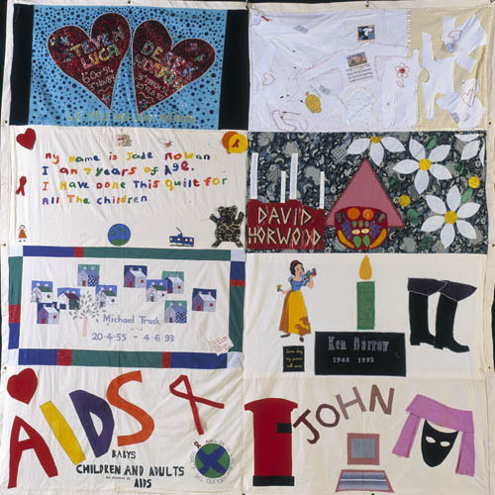
Notes:
It used to be that an HIV diagnosis was very bad news.
HIV was first identified in the 1980s, but it took until 1996 to develop life-saving treatment. Almost everyone who was diagnosed in the early years of HIV, eventually saw the virus progress to AIDS.
We wear the Red Ribbon to remember them too.
This picture is of the UK AIDS Memorial Quilt, made up of hundreds of patchwork tributes by the friends and families of those lost to AIDS.

Slide 16
“Women living with HIV are just like you and me. HIV is a tiny virus which does not define who we are… With access to treatment, care and support, people living with HIV can lead healthy and fulfilling lives, work, study and have relationships and families - if that is what they wish.”
Notes:
Since the development of effective treatment, this is no longer the case. HIV does not impact life expectancy in the UK.
Angelina is from London, she’s a former performance artist, and she has been living with HIV for 27 years. Her message?:
Women living with HIV are just like you and me. HIV is a tiny virus which does not define who we are… With access to treatment, care and support, people living with HIV can lead healthy and fulfilling lives, work, study and have relationships and families - if that is what they wish.

Slide 17
Notes:
The fifth fact is that there are many ways to prevent HIV.
Q: We’ve named a few already. Think: can you name any?

Slide 18
How to prevent HIV
U=U
Notes:
Q: What methods can be used to prevent HIV from being passed on?
A: To prevent HIV being passed on, the following methods can be used:
Condoms: Using condoms when having sex can prevent HIV from being passed on. Condoms have the additional benefit of preventing all other STIs and pregnancy too.
PEP and PrEP: PrEP is a pill you can take, daily or when needed, to prevent exposure to HIV from sex. It is available on the NHS to those who are most at risk of HIV. PEP can be taken 48 hours after possible exposure to HIV, for example, if a person has had unprotected sex. It can be prescribed in sexual health clinics or in hospital.
U=U: U=U means ‘Undetectable = Untransmissible’. When someone living with HIV is on good treatment, the amount of virus in the body is reduced to ‘undetectable’ levels and they can’t pass on HIV to their sexual partners. Most people living with HIV in the UK are undetectable.
Clean needles and other ways of reducing harms from injecting drug use: Clean needles and other equipment are distributed to people who inject drugs to prevent sharing of needles.
For more information on U=U, see http://i-base.info/htb/32308
Top tip
You might want to mention here where students can access free condoms in your local area (e.g. available from the school nurse, young people’s sexual health clinic, etc.) If you’re not sure, you can find this information at https://www.nhs.uk/service-search/Sexual-health-services-for-young-people/LocationSearch/735
A: In the UK, the two main routes of getting HIV is by:
Having sex without condoms
Sharing needles and injecting equipment
Anyone can get HIV if they are exposed to HIV via these routes.
Elsewhere in the world, there is also a risk for pregnant women passing HIV on to their babies, but this doesn’t really happen in the UK because HIV treatment stops this from happening.
These are the only ways HIV can be passed on. There is no risk of passing on HIV through day-to-day contact, touching, kissing or any other way.
Top tip
Other examples of things you can’t get HIV from include biting, spitting, sharing cutlery, loo seats or sharing tooth brushes.

Slide 19
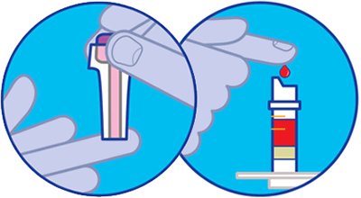
Getting tested for HIV
Image source: Terrence Higgins Trust
Notes:
People find out if they have HIV by getting tested for it. An HIV test is usually taken by a finger-prick test. You can get an HIV test at your doctor’s or at a sexual health clinic.
If you start having sex, it’s important to get tested regularly so you know your status. Do you remember the 1 in 12 people who don’t know they have HIV from the previous slide? This is a problem because if someone has HIV, the longer it’s left untreated the more ill they can become.
Top tip
You might want to mention here where students can go for an HIV test in your local area. You can find this information at https://www.nhs.uk/Service-Search/HIV-testing/LocationSearch/418

Slide 20
Living with HIV
HIV Stigma: When people living with HIV are judged and treated badly because of prejudice and assumptions about HIV.
Notes:
Although we now have great treatment and people living with HIV can live long and healthy lives, they still experience HIV stigma.
When people living with HIV are judged and treated badly because of prejudice and assumptions about HIV, we call this ‘HIV stigma’.
Stigma persists because many people don’t understand the reality of HIV and are scared of it.
But people living with HIV deserve our respect and dignity, just like anyone else.

Slide 21
Living with HIV
Notes:
NOTE FOR SPEAKER: this 5-minute video sees three people living with HIV in the UK tell their story.

Slide 22
Living with HIV
Imagine you have been diagnosed with a long term health condition, but you are nervous that people might treat you differently when they find out, even though you can live a long, healthy life….
1 in 8 said they had never told anyone about their HIV status other than healthcare professionals
1 in 5 people needed help with loneliness and isolation in the past year
Image source: Changing Perceptions
Notes:
Imagine you have been diagnosed with a long term health condition, but you are nervous that people might treat you differently when they find out, even though you can live a long, healthy life….
In 2018, 1 in 8 people living with HIV said they had not shared their HIV status with anyone other than healthcare professionals. While some simply may not feel the need to talk to others about HIV, for others this could contribute to significant loneliness and isolation, especially if it is a barrier to forming relationships with others. 1 in 5 people living with HIV said that they needed help with loneliness and isolation in the past year.

Slide 23
Living with HIV
….and even when you step into health care settings to receive the treatment that you need, you find that you are treated differently.
1 in 10 had actually been denied or refused a health treatment or procedure that they needed
1 in 3 worried that they would be treated differently to other patients
Image source: Changing Perceptions
Notes:
….and even when you step into health care settings to receive the treatment that you need, you find that you are treated differently.
Even in the NHS, HIV stigma still exists. One in 10 people living with HIV in the UK have been refused healthcare or delayed a treatment because of their HIV status. One in 3 people living with HIV have been worried that they would be treated differently to other patients.

Slide 24
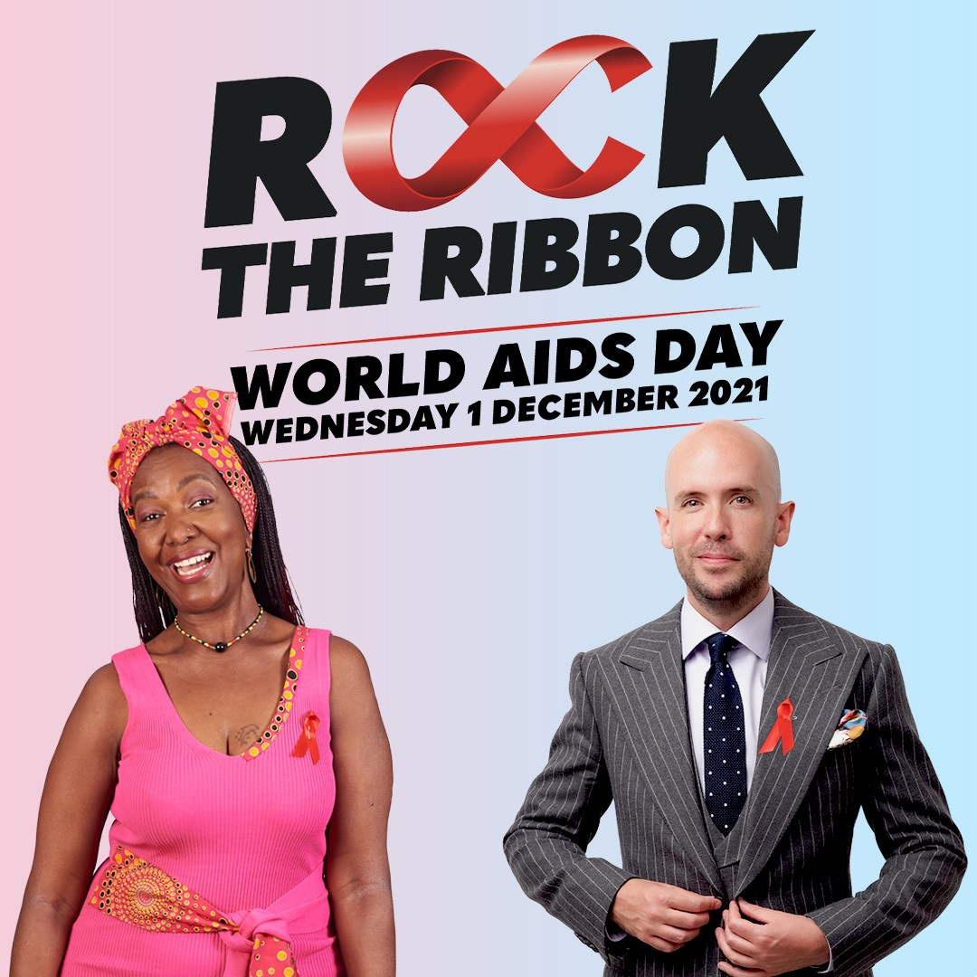
What can you do?
#RocktheRibbon
Challenge HIV stigma
Treat people living with HIV with respect
Organise a fundraiser for National AIDS Trust
Notes:
We can all do our bit to tackle HIV stigma and support people living with HIV.
#RocktheRibbon
Every World AIDS Day, we ask people to ‘Rock the Ribbon’. We are encouraging everybody to wear their red ribbon with pride, show support for people living with HIV and help us end HIV in the UK for good by getting HIV transmissions to zero and fighting stigma.
Top tip
If you order ribbons from us in advance, you could ask students if they would like to purchase a ribbon as they leave the assembly or during their lunch break. You can order red ribbons for free here.
Challenge HIV stigma
You can also challenge HIV stigma with the key facts you’ve learned today. If you hear someone saying stigmatising things about HIV, challenge them yourselves or tell an adult. Tell your friends and parents about this assembly and what you have learned. You can learn more HIV facts at www.nat.org.uk
Treat people living with HIV with respect
If someone tells you they have HIV, don’t tell anyone else without their permission. Be supportive, respect their confidentiality and treat them like you would treat anyone else.
Organise a fundraiser for National AIDS Trust
Organise an event at your school or in your community to raise much-needed funds National AIDS Trust. We’ve got a list of great ideas for fundraising events at http://www.worldaidsday.org/fundraising and we can send you all the materials you need to organise a fun and successful fundraiser. See www.worldaidsday.org for more information.

Slide 25
Summary
HIV is a virus that attacks the body’s immune system. It is not the same as AIDS.
With effective medication, people living with HIV can’t pass on the virus and can live as long as anyone else.
HIV stigma can make life difficult for people living with HIV.
You can support World AIDS Day by wearing a red ribbon, keeping yourself and others informed about HIV and treating people living with HIV with respect.
Notes:
HIV is a virus that attacks the body’s immune system. It is not the same as AIDS.
With effective medication, people living with HIV can’t pass on the virus and can live as long as anyone else.
HIV stigma can make life difficult for people living with HIV.
You can support World AIDS day by wearing a red ribbon, keeping yourself and others informed about HIV and treating people living with HIV with respect.

Slide 26
Some final words
“HIV can affect anyone regardless of gender, race, religion or sexuality. But protecting and respecting yourself and others is as simple as a health checkup and using protection and or prevention.”
Notes:
Jimmy is 32, he’s an ex-Ska-Punk rockstar, and he’s been living with HIV for 7 years.
His message this World AIDS Day?
“HIV can affect anyone regardless of gender, race, religion or sexuality. But protecting and respecting yourself and others is as simple as a health checkup and using protection and or prevention.”

Slide 27
We’re the UK’s HIV rights charity. We work to stop HIV from standing in the way of health, dignity and equality, and to end new HIV transmissions. Our expertise, research and advocacy secure lasting change to the lives of people living with and at risk of HIV.
www.nat.org.uk

